Slide 1

Study Buddy App
Team Members: Bohan Lin, Dexiao Zhang, Junzhe Chen, Ittoop Shinu Shibu, Melissa Cron, Qiuting Zhao

Slide 2
Study Buddy App
Agenda
Project Overview​
Requirement Analysis
System Architecture​
Frontend Design Process​
Login System​
Database & ERD​
Study Interfaces​
Game Interface
Home Page & Component Diagram
Business Logic & Key Algorithms
Testing & CI/CD
Next Steps
Demo

Slide 3

About Study Buddy
Study Buddy App
Cross-platform via React Native + Node.js + SQLite
Features:
Study timer & goal tracking
Pet growth system
Statistics & achievements
Mini-games during breaks
Help students stay focused using gamified study tracking.

Slide 4
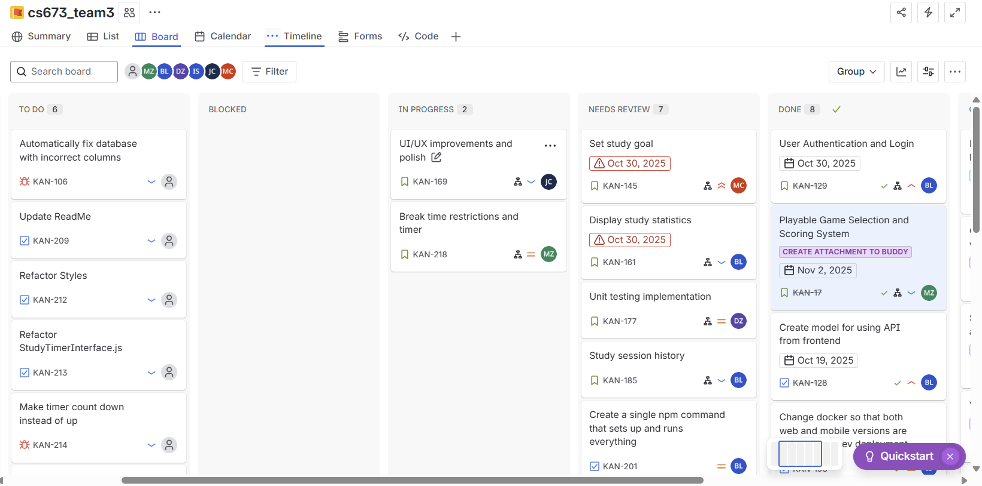
Requirement Analysis
Study Buddy App

Slide 5
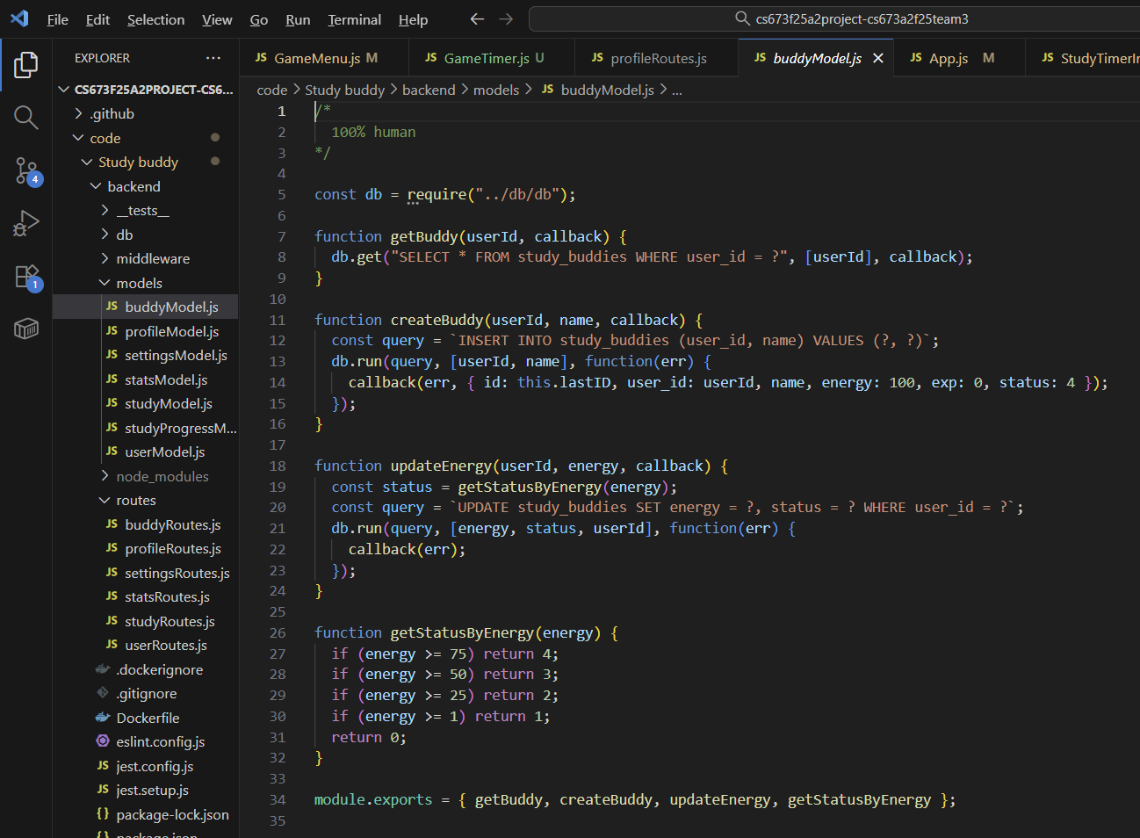
System Architecture
Study Buddy App
3-Tier Architecture:
Frontend: React Native (Expo)
Backend: Node.js + Express.js
Database: SQLite
RESTful API links front & back
CI/CD pipeline with GitHub Actions and Docker

Slide 6


Frontend Design Process
Study Buddy App
Start from Figma / Flutter to explore suitable UI templates​
Build an initial demo prototype for visualization​
Test and adjust the layout and responsiveness​
Recreate the final design using React for implementation​
Notes:
Our front-end design primarily involves finding a suitable framework like Figma or Flutter to determine the overall style of the interface.
Then, I build a demo to preview the layout and test user interactions.
After verifying usability, I recreate the final UI using React—this allows for dynamic rendering and component-based development.

Slide 7
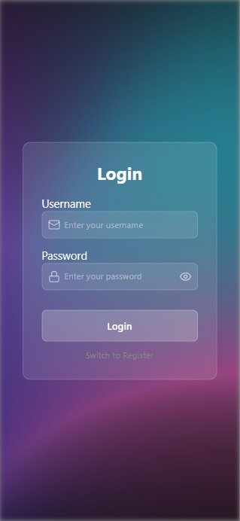
Login System
Study Buddy App
Frontend
(UI & Logic)
Backend
(Database & Validation)
Clean and minimal login interface (as shown on the right)​
Includes username & password fields with floating labels​
Password visibility toggle for better user experience​
Responsive design with gradient background​
“Switch to Register” for easy navigation​
Connected to SQLite database​
Stores user data in users table (username, password, created_at)​
Enforces unique usernames and secure password storage​
Supports session persistence (localStorage / sessionStorage)​
Easily extendable for authentication middleware​
Notes:
This page showcases our login system. On the front end, we've designed a clean and modern login interface. The 'Switch to Register' feature allows users to easily navigate to the registration page.
On the back end, the login system connects to an SQLite database. User information is stored in the `users` table, and the system uses unique constraints to ensure that usernames are not duplicated. We also use `localStorage` or `sessionStorage` to store user login states. Furthermore, we chose between traditional databases and NoSQL databases, finding that NoSQL databases are easier to scale than traditional databases.

Slide 8
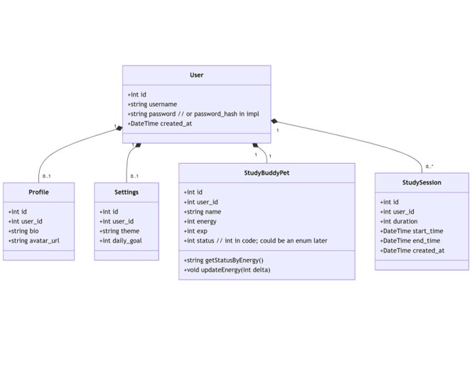
Database & ERD
Study Buddy App
Main Tables
userModel.js: manages login credentials
profileModel.js: stores name/avatar
settingsModel.js: preferences (theme, daily goal)
studyModel.js: study session records
buddyModel.js: virtual pet attributes
statsModel.js: aggregate data for analytics
Notes:
"On this page, I've shown the entire ERD structure of the database. The users table is the core, and it's linked to multiple functional module tables via foreign keys, such as learning records, progress, settings, and learning partners."

Slide 9
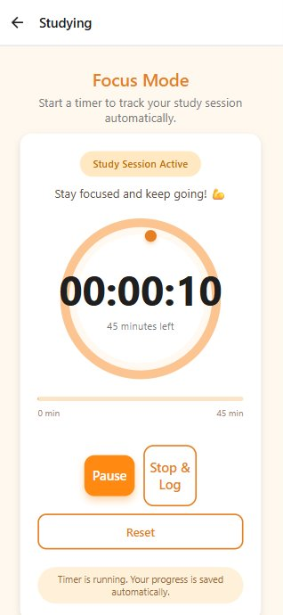
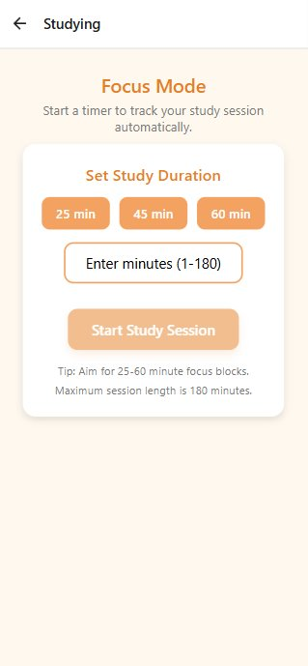
Study Interfaces
Study Buddy App
Start/pause timer (countdown)
Logs start & end times
Auto-syncs to backend /api/study/me
Displays goal progress in stats screen
Users can set their weekly study goals​
Study time is recorded in the database (study_sessions table)​
Progress is persistent — not reset when app closes​
Data syncs with study_progress to resume sessions
Notes:
We currently have four main UI pages, and the most important one is the Study Page. Here, users can choose their weekly study time goals, which are recorded in the database. If the user pauses or closes the app, the progress is not reset but saved — ensuring accurate tracking of study time.

Slide 10
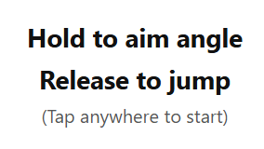
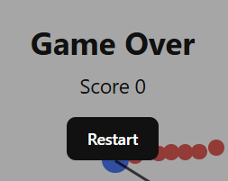
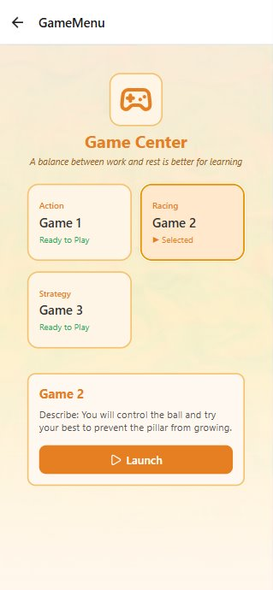
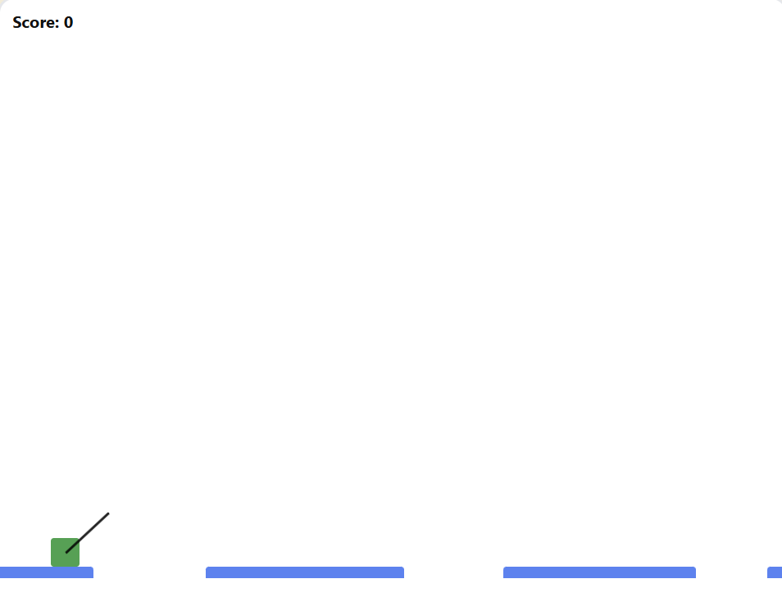
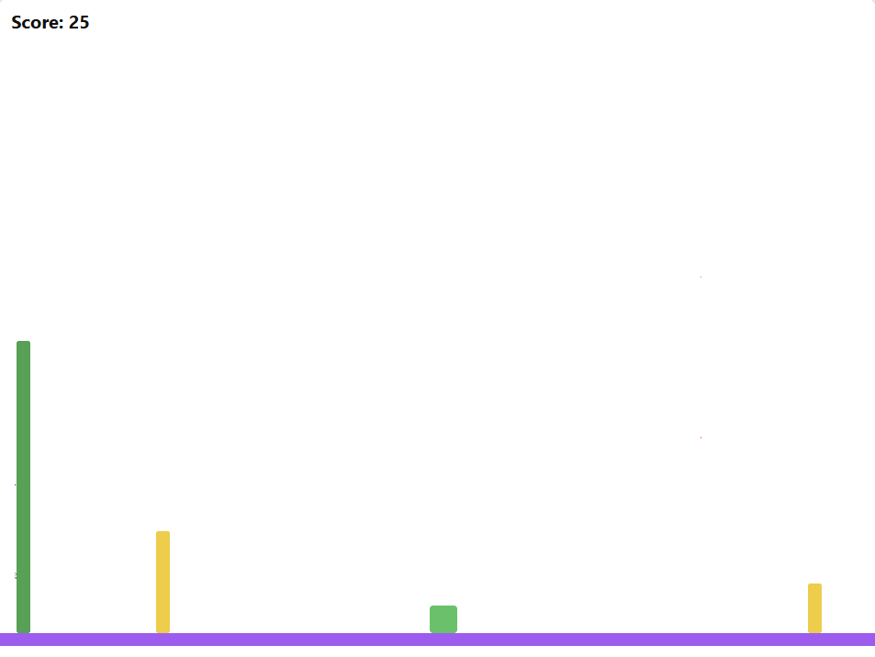
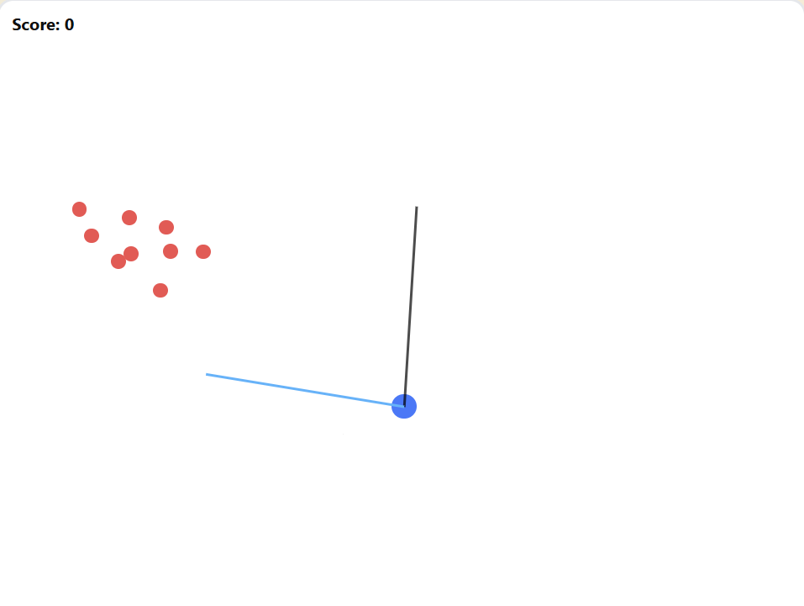
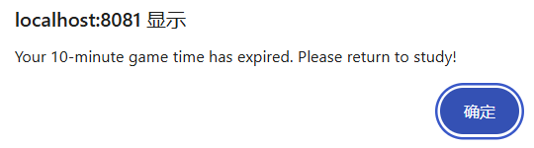
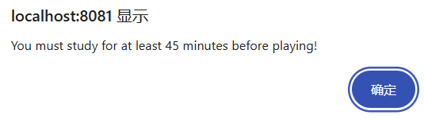
Game Interface
Study Buddy App
Game 1
Game 2
Game 3
Score update on time survive
Score update on bamboo collision
Score Update on enemy destroy

Slide 11
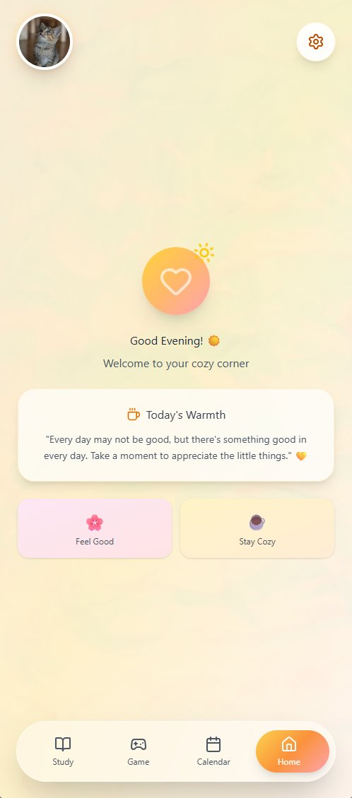
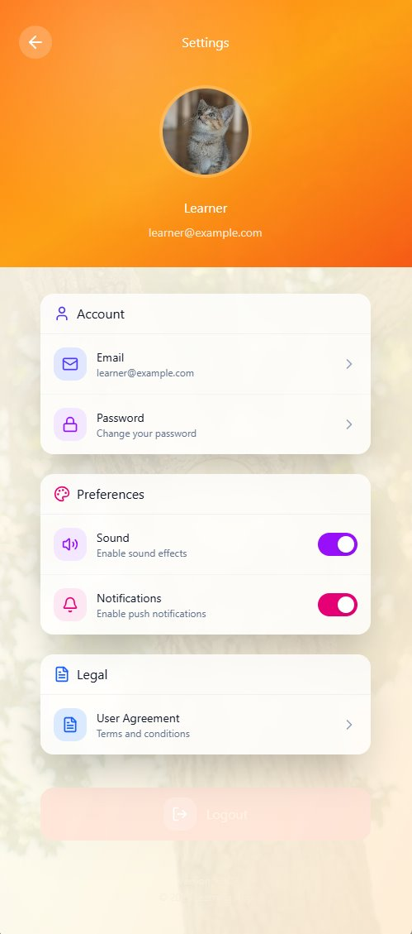
Home Page
Study Buddy App
Navigation Bar:​
Connects the four main pages (Study, Game, Calendar, Settings)​
Provides a clear and direct path to each feature​
Enhances usability and reduces navigation time​
Consistent layout across all screens​
Home Page (Buddy System):​
Planned as the main hub of the app​
Displays and interacts with the user’s Buddy​
Encourages daily learning through emotional engagement​
Combines productivity with gamified progress tracking​
Notes:
In the future design, we plan to add a navigation bar and a main Home interface. As a user, I want to quickly find what I need without searching through multiple pages. The navigation bar will connect the four main pages — Study, Game, Calendar, and Settings — making the app easier to use.
The Home page will host our virtual companion, the Buddy. This Buddy will accompany the user’s study journey, providing encouragement and a sense of growth. The idea is to combine productivity with emotional motivation — helping users learn something new every day.

Slide 12
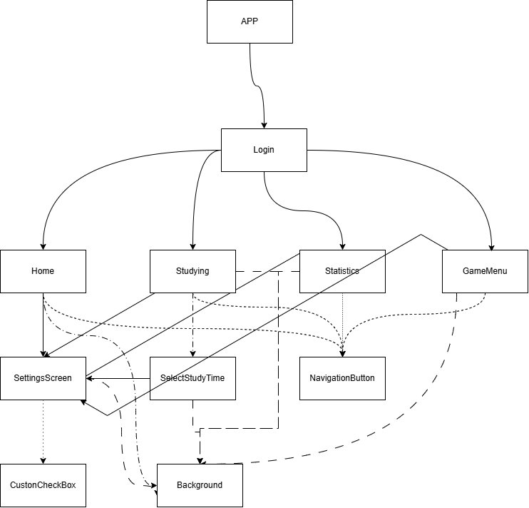
Component Diagram
Study Buddy App
Notes:
This page shows our frontend component structure. If we need to add new pages in the future, we can easily identify where they should be added and how they connect to the existing components.

Slide 13
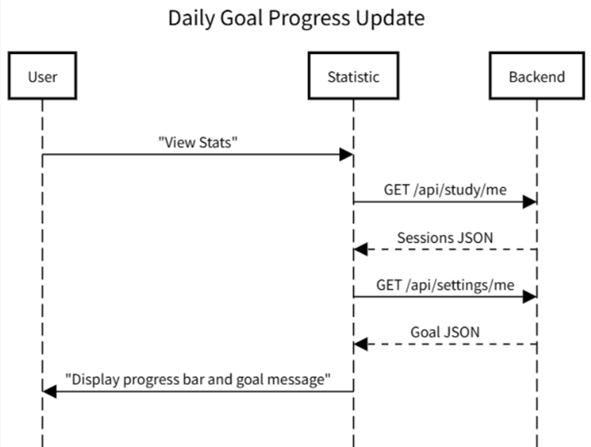
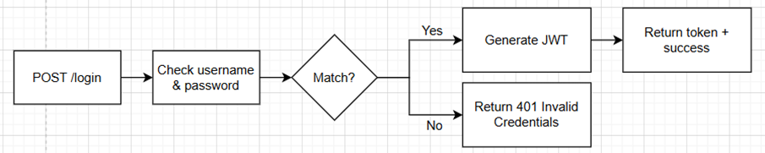
Business Logic & Key Algorithms
Study Buddy App
Study Timer Algorithm: countdown, stop condition, duration calculation.
Goal Evaluation: sum of durations for today ÷ daily goal × 100.
Buddy Energy: increases with study time, decays over inactivity.
JWT Validation: verifies token per request.

Slide 14
Study Buddy App
RESTful API
POST /api/users/register – Create user.
POST /api/users/login – Authenticate user.
GET /api/study/me – Retrieve all study sessions.
POST /api/study/me – Add a new session.
GET /api/settings/me & POST /api/settings/me – User settings.
GET /api/profiles/me & POST /api/profiles/me – Profile management.

Slide 15

Study Buddy App
Testing Overview
Unit Tests
Integration Tests
Acceptance Tests
CI/CD
Verify individual components and functions in isolation.
Example: JWT validation and error handling.
Confirm that backend routes and database models interact correctly.
Ensure correct insertion, retrieval, and validation of study sessions.
Simulate full API workflows from user actions to DB persistence.
Tools: Jest + Supertest + mock database (SQLite in-memory).
Every GitHub PR triggers Jest tests and linting through GitHub Actions.
Manual system tests run with Postman collections.

Slide 16
Study Buddy App
Manual Testing
Screen Traversal: Verify that all screens (Home, Study, GameMenu, Settings) are accessible.
Clock Behavior: Ensure countdown ends correctly and switches state.
Data Persistence: Confirm sessions remain after app restarts.
Bug Tracking: Failures recorded in Jira (e.g., KAN-214 – Timer increment issue).

Slide 17
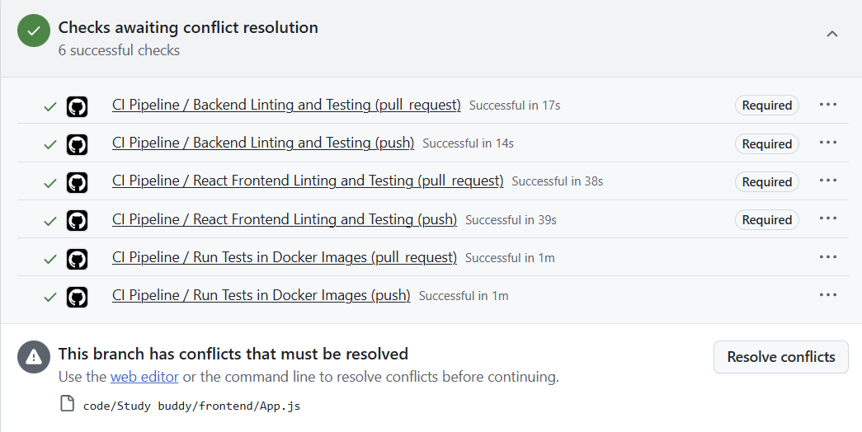
CI/CD & Deployment
Study Buddy App
CI/CD via GitHub Actions (.github/workflows/github-actions.yml).
Trigger on PR to develop or main.
Runs: Linting, Jest Tests, Docker build.
CD step: Auto-build container (manual deploy to Heroku/AWS).

Slide 18
Our Next Step
Study Buddy App
Security (Input Sanitization)
Unified UI design
True realization of Buddy (It did grow in Statistics but won’t die)
Customizing Buddy

Slide 19
Demo
Study Buddy App

